Slide 1
Simple Password Generator By Java
Here is where our presentation begins

Slide 2
Content of this Password Generator
Here

Slide 3
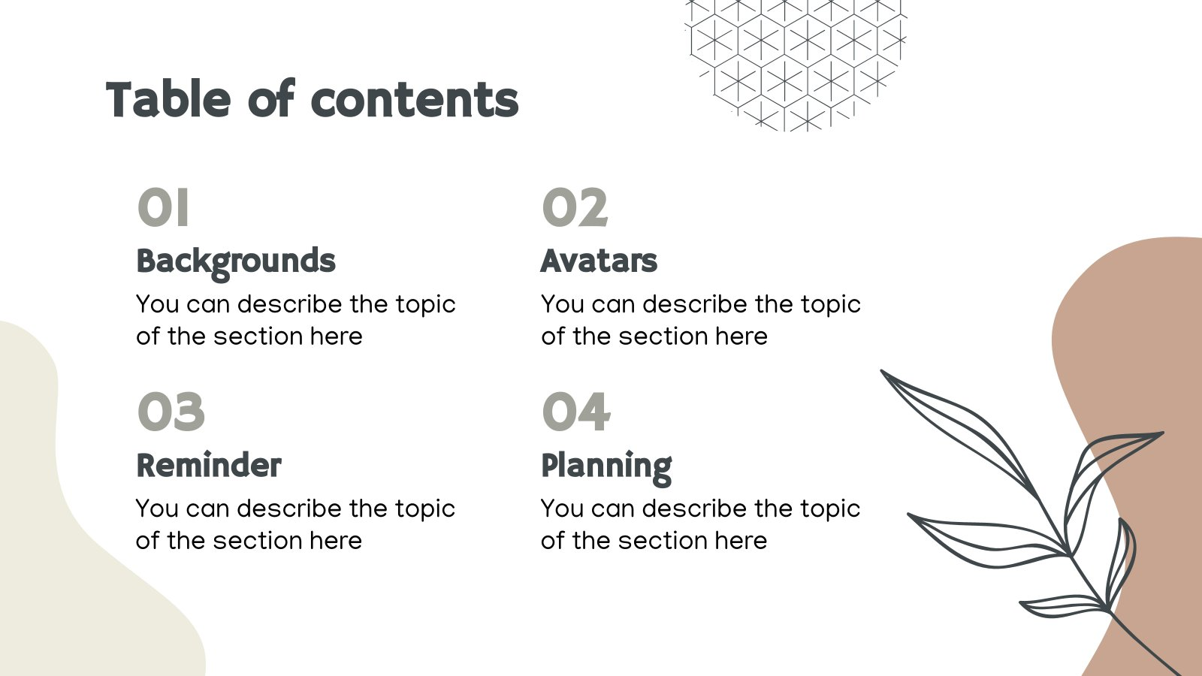

Slide 4
During a video call
On the bottom right, click More
Click Change background
To completely blur your background, click Blur your background
To slightly blur your background, click Slightly blur your background
To select a pre-uploaded background, click a background
To upload your own image for your background, click Add
Tip: Your camera is automatically turned on when you click Change background
Changing your background may slow down your device. You may want to turn this feature off to allow other apps to run faster on your computer

